Slide 1

Using Big Data To Solve
Economic and Social Problems
Professor Raj Chetty
Head Section Leader Rebecca Toseland
Photo Credit: Florida Atlantic University

Slide 2
Government Intervention in Markets for Health Insurance
Data show that insurance coverage leads to moderate increases in health care use and improvement in health outcomes
Suggests that access to health insurance can be valuable for improving population health
But does not necessarily follow that government needs to provide this insurance
  Why can’t people buy it themselves in private markets, like they do other products like cars?

Slide 3
Demand for Health Insurance
Finkelstein, Hendren, and Shepard (2017) show why government intervention is essential to sustain markets for insurance
Study Massachusetts public universal health insurance program
  Introduced in 2006; predecessor to the national Affordable Care Act
Research design: exploit discontinuities in subsidies for insurance based on income level

Slide 4
Subsidy and Premium Discontinuities in Massachusetts in 2011
400
Insurer Price
300
Public
Subsidies
$ per month
200
$116
100
$77
“Affordable Amt.”
(cheapest plan)
$39
Enrollee
Premium
0
$0
135
150
200
250
300
Income, % of Federal Poverty Line

Slide 5
Number of Individuals Enrolled in a Health Insurance Plan by Income Level
5000
RD = -1054
(318)
4000
%Δ = -26%
RD = -641
3000
(157)
Number with Insurance
%Δ = -27%
RD = -326
2000
(99)
%Δ = -25%
1000
0
135
150
200
250
300
Income, % of Federal Poverty Line

Slide 6
Estimated Demand Curve for Health Insurance
125
(0.44, $116)
250% FPL
100
75
(0.58, $77)
(0.56, $77)
Insurance Premium ($/month)
200% FPL
50
(0.76, $39)
(0.70, $39)
25
150% FPL
0
(0.94, $0)
20%
40%
60%
80%
100%
Share Purchasing Health Insurance

Slide 7
Demand for Health Insurance
Demand for health insurance among the poor falls very rapidly as price rises
  Reducing subsidies would drastically reduce the number of individuals insured
Moreover, sicker people remain insured, increasing average costs for insurers (“adverse selection”)

Slide 8
Adverse Selection: Average Costs Paid by Insurance Companies
420
RD = 45.3
RD = 33.6
RD = 5.9
(7.2)
(8.8)
(11.5)
%Δ = +14%
%Δ = +10%
%Δ = +2%
380
$ / month
340
300
133
150
200
250
300
Income, % of Federal Poverty Line

Slide 9
Lessons on Markets for Health Insurance
Government intervention is critical to sustain markets for health insurance for two reasons:
  Low-income individuals are very sensitive to price → will not buy insurance if not subsidized or provided by government
  Healthiest low-income individuals are least likely to buy → insurance companies get stuck with higher costs, making market collapse
Hendren: Trumpcare would effectively end enrollment in insurance markets for families that make less than $75,000 a year

Slide 10
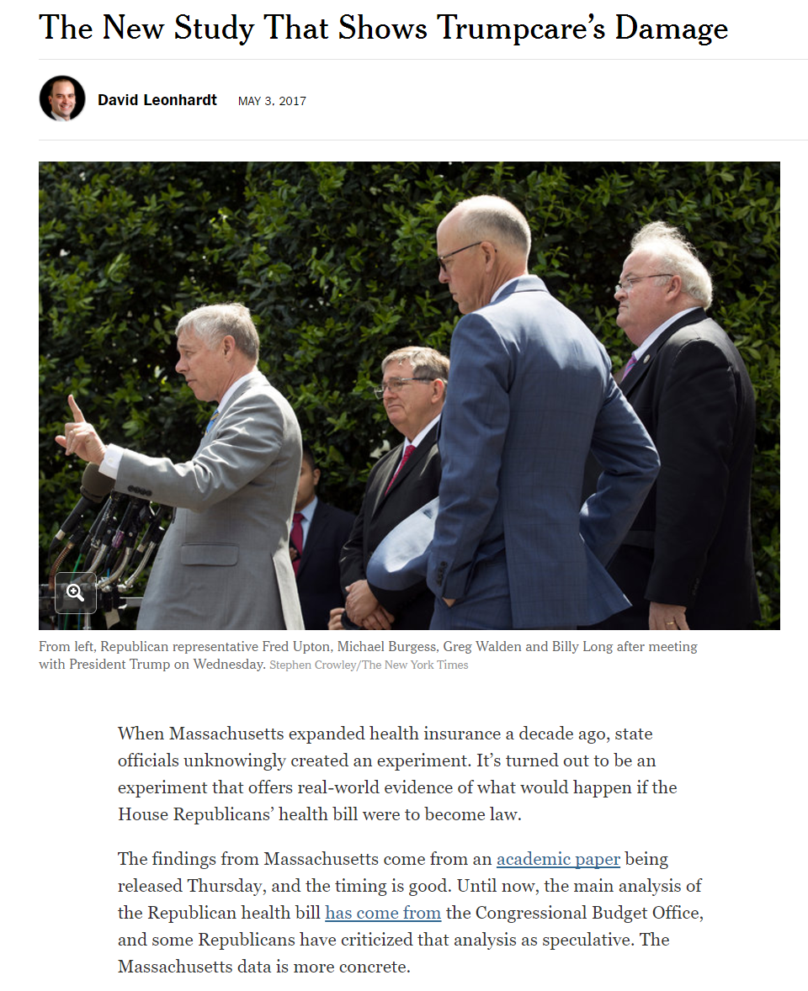

Slide 11
Environmental Economics

Slide 12
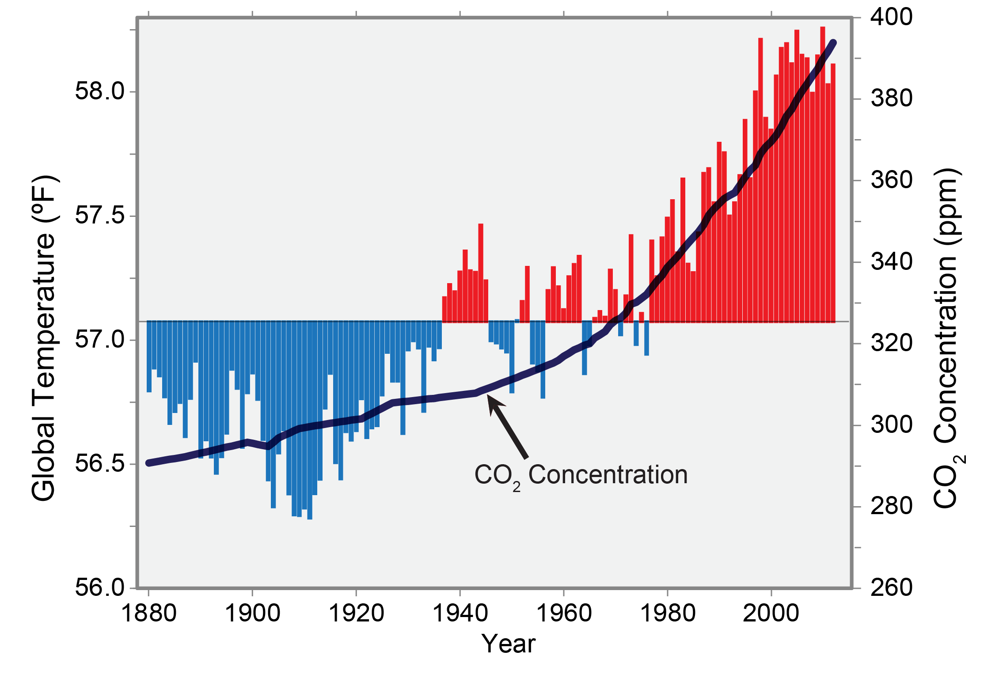
Trends in Global Temperature and Carbon Dioxide Concentration
Source: Karl, Melillo, Peterson 2009

Slide 13
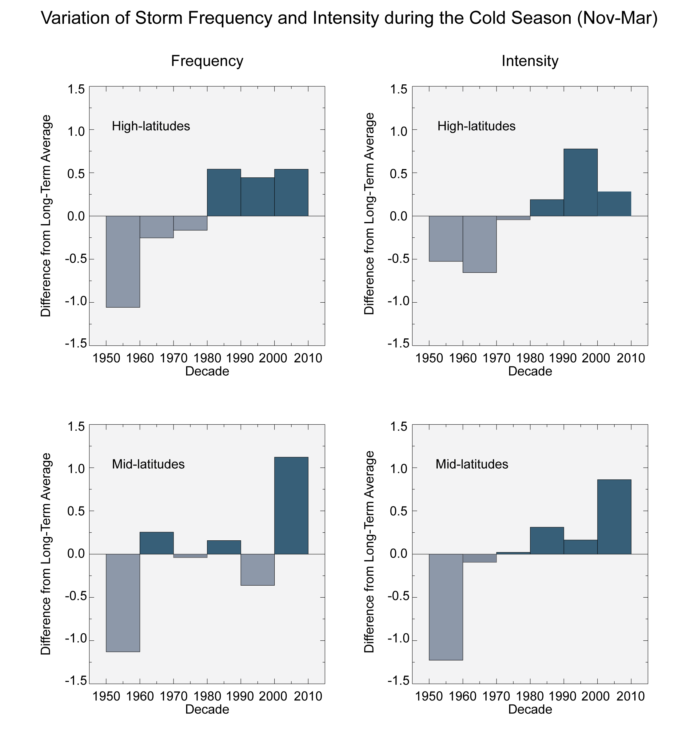
Trends in Frequency and Intensity of Winter Storms
Source: CCSP 2008

Slide 14
Climate Change and Environmental Economics
Idealistic response to dramatic change in climate: we should preserve environment in its original state, no matter the cost
Environmental economists take a more practical perspective
  Tradeoff between economic benefits and environmental costs → need to price environmental damage created by each policy to more forward
  Humans have adapted in the past (e.g., using air-conditioning), mitigating costs of environmental change

Slide 15
Climate Change and Environmental Economics
Example: building a new oil pipeline or permitting fracking for gas
  These policies could have significant benefits by reducing costs of resources and effectively increasing people’s incomes
  What is the environmental damage created by these policies?
Big data is helping us make progress in answering this question
  New data permits more effective comparison of alternative policies
  And helps us find ways to preserve the environment while minimizing economic costs

Slide 16
Conceptual Background: Social Problems
Final two topics in this course (environment and crime) are social problems because they involve externalities
Externality: one person’s behavior directly affects another person’s well-being
  Ex: You drive a car that emits pollution → everyone pays a price
Different from the outcomes we have considered thus far
  Income, education, health: benefits accrue primarily to a given individual

Slide 17
Conceptual Background: Social Problems
Tackling social problems requires different types of data and methods
Need to measure impacts on everyone, not just on a given person’s income or health
  Contrast with analysis of impacts of class size on students’ test scores
  Group-centric rather than individual-centric empirical analysis
Goal is to change people’s behavior to move away from what is best for them personally
  Contrast with college outreach programs
  Focus on changing behavior to achieve social aims rather than individual benefits

Slide 18
Economics of Externalities
Price of
Gasoline ($/gal.)
Consumer Demand for Gas
Cost of Producing Gas
P_{M} = $3
0
Q_{M} = 150
Gallons
(billions)

Slide 19
Economics of Externalities
Price of
Gasoline ($/gal.)
Consumer Demand for Gas
P_{S} = $4
Social Cost of Gasoline
Cost of Producing Gas
P_{M} = $3
0
Q_{M} = 150
Gallons
(billions)

Slide 20
Economics of Externalities
Price of
Gasoline ($/gal.)
Consumer Demand for Gas
Social Cost of Gas Exceeds Benefit to Consumers
P_{S} = $4
Cost of Producing Gas
P_{M} = $3
0
Q_{S} = 100
Q_{M} = 150
Gallons
(billions)

Slide 21
Two Key Questions in Environmental Economics
Price of
Gasoline ($/gal.)
Consumer Demand for Gas
P_{S} = $4
Question 1: How can we measure the social cost of pollution?
Cost of Producing Gas
P_{M} = $3
0
Q_{S} = 100
Q_{M} = 150
Gallons
(billions)

Slide 22
Two Key Questions in Environmental Economics
Price of
Gasoline ($/gal.)
Consumer Demand for Gas
P_{S} = $4
Cost of Producing Gas
P_{M} = $3
0
Q_{S} = 100
Q_{M} = 150
Gallons
(billions)
Question 2: What policies can we use to reduce pollution/improve environment?

Slide 23
Social Costs of Climate Change and Pollution

Slide 24
Social Cost of Carbon
Researchers have estimated social costs of many different types of pollution, ranging from toxic air pollution to water pollution
Given link between CO₂ emissions and climate change, carbon emissions have received the most attention
Governments now use estimates of “social cost of carbon” when evaluating alternative policies
Conceptual question: how much does an additional unit of carbon emissions cost society due to environmental damage?
  Calculating this cost is challenging and is the subject of much research

Slide 25
Estimating the Social Cost of Carbon
Three general steps in estimating the social cost of carbon:
  Predict impact of 1 extra ton of CO₂ on climate using a climate forecasting model
  Measure impacts of changes in climate on economic productivity, health, property damage, etc.
  Calculate current social cost by converting future costs to current dollars (discounting)
First question is the subject of research in environmental science
Focus here on how big data is enabling social scientists to obtain better answers in steps 2 and 3

Slide 26
Estimating the Impacts of Climate Change
Recent studies estimate causal impacts of climate change on many outcomes
  Combine data on outcomes from various sources with detailed measurements of temperature from local monitors
General approach: estimate models that relate outcomes to temperature fluctuations across days or years
  Comparisons across time within areas, not comparisons across areas
  Temperature variation random within areas → identify causal effects
  Note that this picks up short-run effects, ignoring potential for adaptation
Carleton and Hsiang (2016) compile results of several of these studies

Slide 34
Effects of Adaptation
How do these short-run impacts change if society has time to adapt?
Challenge: difficult to directly identify causal impacts of long-term trends in climate
  Lots of other things are changing as climate changes
Instead, compare effects of short-run changes in places that have had time to adapt vs. places that have not
  Ex: does a heat wave have smaller effects in areas that experience heat waves regularly?
  Do temperature fluctuations have smaller costs in advanced economies?

Slide 35
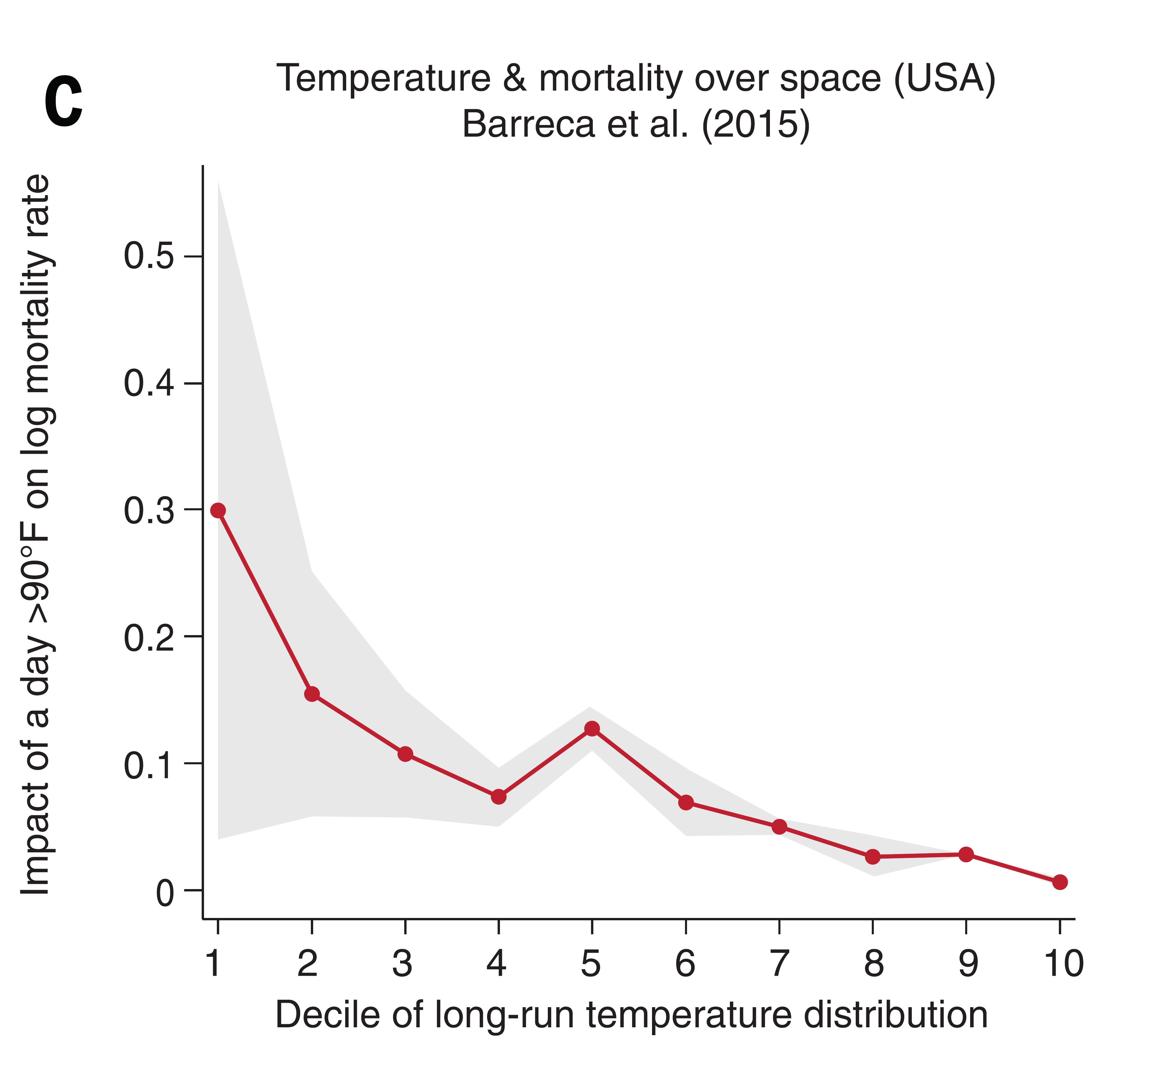

Slide 36
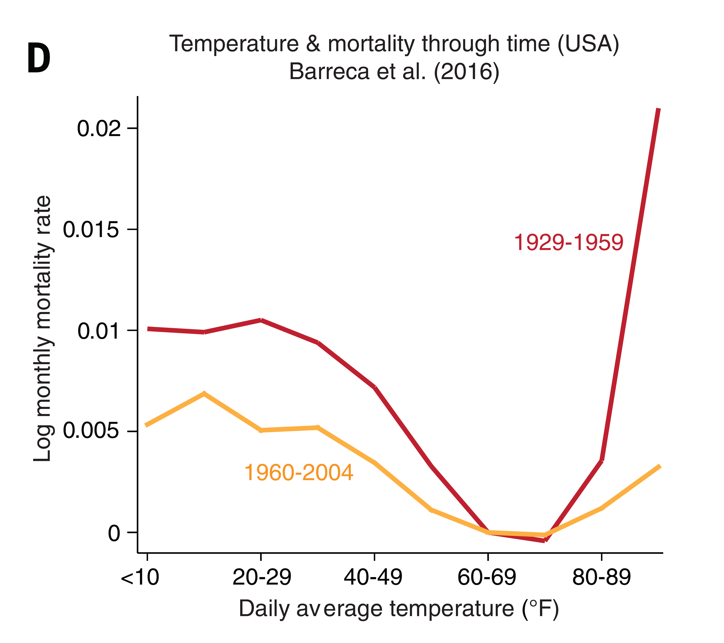

Slide 37
Impact of Daily Temperature Fluctuations on Mortality Rates in India vs. the U.S.
Log Mortality Rate (Deviation from Mean)
Daily Average Temperature (Fahrenheit)
Source: Burgess, Deschenes, Donaldson, Greenstone 2017

Slide 38
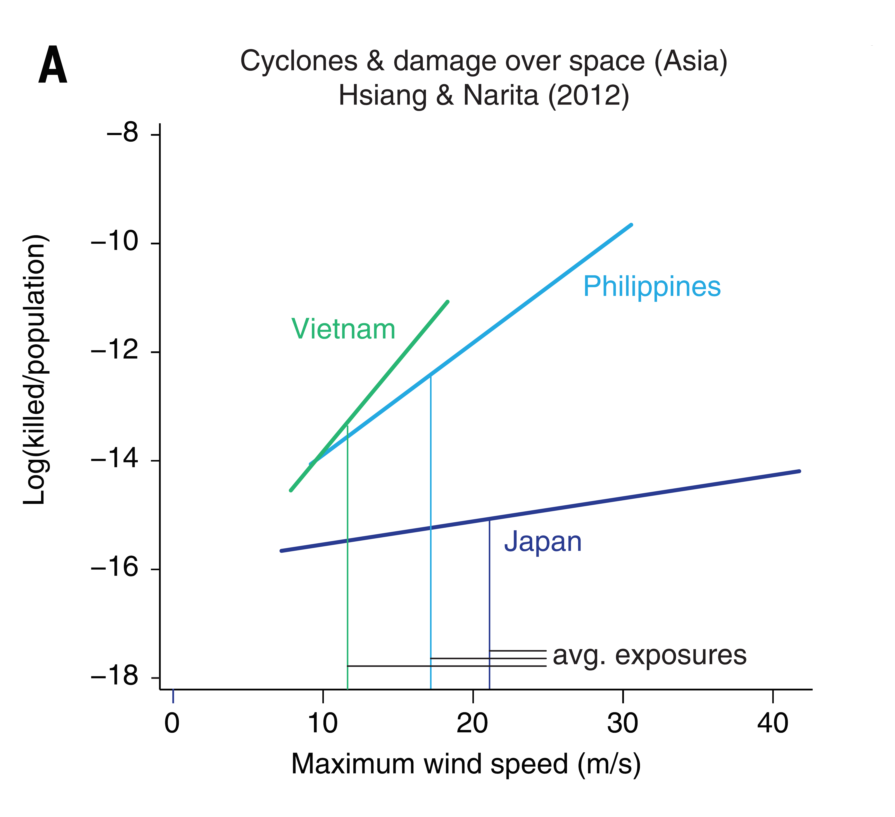

Slide 39
Estimating the Impacts of Climate Change
Burke et al. (2015) results imply that predicted climate change by 2100 will lower global GDP by 23%
This estimate is based on short-run fluctuations in temperature, though Burke et al. argue that long-term impacts are likely to be similar
  No evidence that relationship between temperature and GDP has changed in recent years
Further limitation of these measures: difficult to measure economic output systematically, especially in rural areas in developing countries
Alternative approach: night-time light intensity, based on satellite images

Slide 40
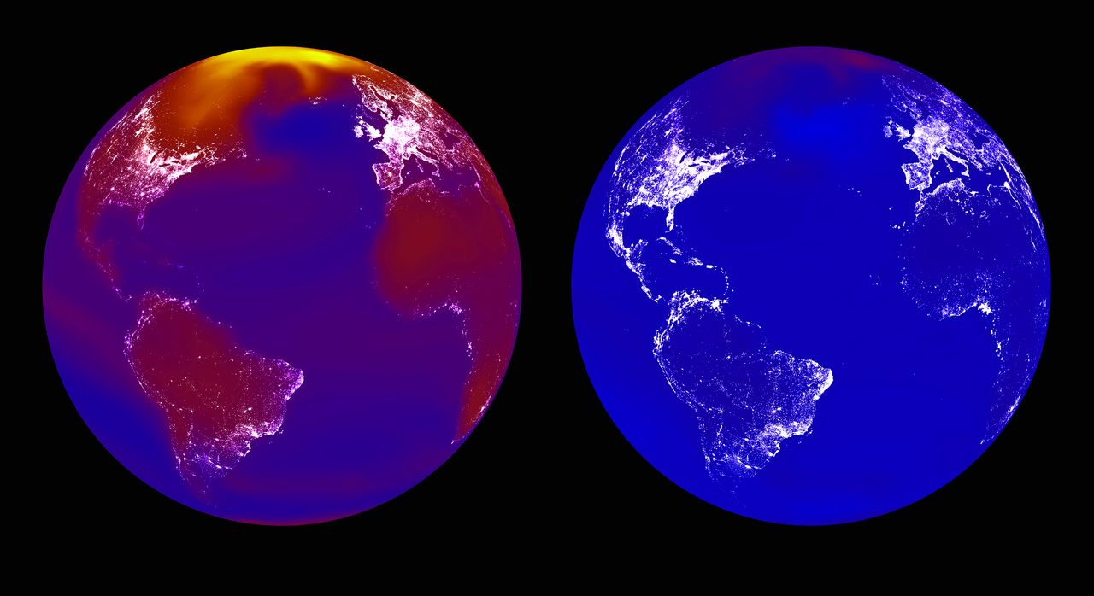
Visualizing the Impacts of Climate Change Using Night-Time Light Intensity
Business as Usual Stringent Emissions Reduction
Source: Carleton and Hsiang (Science 2016)

Slide 41
Impacts of Air Pollution
Similar methods can be used to examine the impacts of other environmental damage
Isen et al. (2014) examine impacts of air pollution on children’s long-term economic outcomes
Use administrative data from Census and tax records to examine how pollution in birthplace affects children’s employment and earnings at age 30

Slide 42
Using the Clean Air Act to Estimate Causal Effects of Air Pollution
Isen et al. exploit 1970 Clean Air Act to estimate causal effects of air pollution
Clear Air Act placed a ceiling on total suspended particulates that all counties in the U.S. had to abide by
Some counties were already below this ceiling, while others were not
This led to differential changes in pollution across counties…

Slide 43
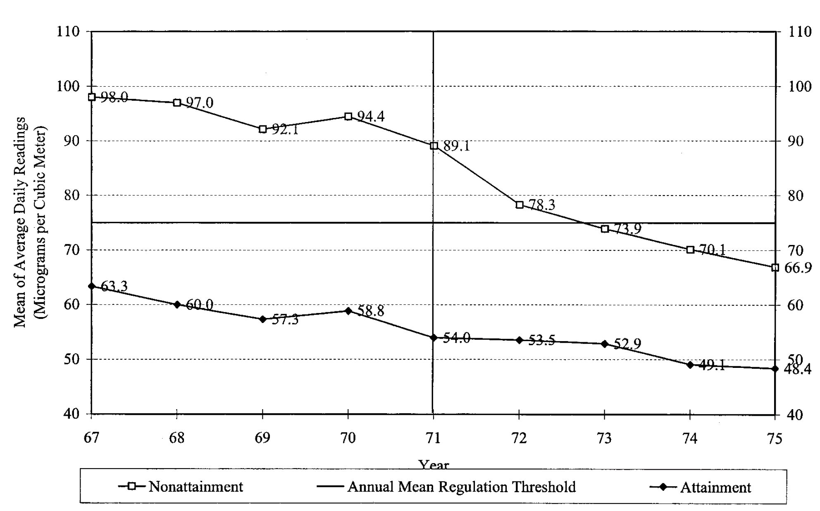
Impact of Clean Air Act on Air Pollution (Total Suspended Particulates)
Source: Chay and Greenstone 2005

Slide 44
Difference-in-Differences Quasi-Experimental Methodology
Exploit differential changes in pollution across counties to implement a differences-in-differences quasi-experimental research design
Idea of diff-in-diff: approximate experiment by comparing an area that experienced a change (“treatment”) with an area that did not (“control”)
Compare differences in outcomes in treatment area vs. control area, before vs. after policy change

Slide 45
Impact of Clean Air Act on Air Pollution (Total Suspended Particulates)
Treatment, Before
Treatment, After
Control, Before
Control, After
Diff in Diff Estimate = (TA – TB) – (CA – CB)
Source: Chay and Greenstone 2005

Slide 46
Difference-in-Differences Quasi-Experimental Methodology
Diff-in-diff avoids biases that can arise from comparing different types of places or simply examining changes over time in a single place
Key identification assumption to make diff-in-diff as good as an experiment: parallel trends
  Absent the policy reform, outcomes would have changed similarly across the two types of areas
  Does not necessarily have to hold, but can be evaluated by examining data before the policy change

